Slide 1
GPS BASED BORDER ALERT SYSTEM FOR FISHERMEN

Slide 2

INTRODUCTION/OBJECTIVE
The livelihood of fishermen is such that he crosses the country border unknowingly. The sea borders between countries are not easily identifiable which is the main reason behind the problem. In day-to- day life we hear about many Tamil fishermen being caught and put under Srilankan custody and even killed.
In this modern, fast moving and insecure world, it is become a basic necessity to be aware of one’s safety. Maximum risks occur for fishermen in situations where they travel on a boat for fishing. In some situations they should not move after some point and they should not enter into other countries area. There is a real necessity in designing a system that can track the vehicle and send the information about the vehicle to the concerned person and alert the fishermen also.

Slide 3
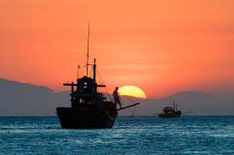
The main application of this system is tracking the vehicle to which the GPS is connected, giving the information about its position whenever required and for the security of each person travelling by the vehicle. This is done with the help of the GPS satellite and the GPS module attached to the vehicle which needs to be tracked.

Slide 4
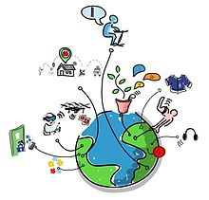
WHAT IS INTERNET OF THINGS(IOT)?
The Internet of Things (IOT) is a system of interrelated computing devices.
The vast network of devices connected to the Internet.
Sensor on it – cars, jet engines, wearable devices, and more.

Slide 5
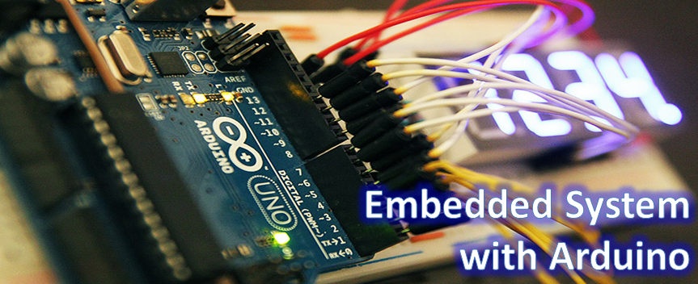
WHAT ARE EMBEDDED SYSTEMS?
An embedded system is some combination of computer hardware and software.
It has Real Time Operating system (RTOS).

Slide 6
Advantages and Disadvantages
Easily Customizable
Low power consumption
Low cost
Enhanced performance
High development effort
Larger time to market

Slide 7
How Embedded Systems are Related to IOT Devices?
IOT devices are typically Embedded systems.
The word "Internet of Things" has two main
parts .
Internet being the backbone of connectivity.
and Things meaning objects / devices .

Slide 8
Hardware and software used
HardWare:
Arduino Uno
DC motor
Bluetooth Module (HC-05)
GPS Module(Adafuit GPS Breakout-66)
Motor Driver(L293D)
Wire(M-F)
Tyres
Car casis
SoftWare:
Arduino IDE
Andriod app

Slide 9
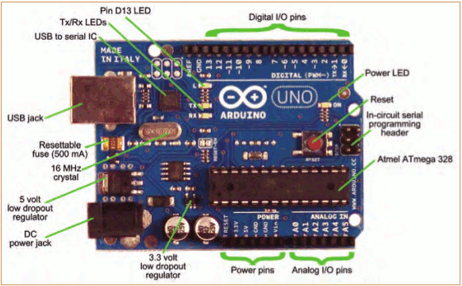
Arduino Uno
Open source platform.
A micro controller.
Base on atmega328

Slide 10
Motor Driver :
L293D Motor Driver.
Bluetooth Module
Bluetooth module is basically a part of serial communication.
We are using HC-05 but we can also use HC-04 and HC-06
Motor :
There are 3 types of motor .
DC ,Servo, Stepper.
We used DC motor as it is cost effective ,flexible and simple to be able to move.

Slide 11
Andriod App:
We have created an andriod app to connect our robot to mobile with Bluetooth module.
The app is build using MIT App Inverter .
GPS Module :
GPS module is a device which receive signals form the satellite and provide information about longitude.
We are using GPS module Neo 6M

Slide 12
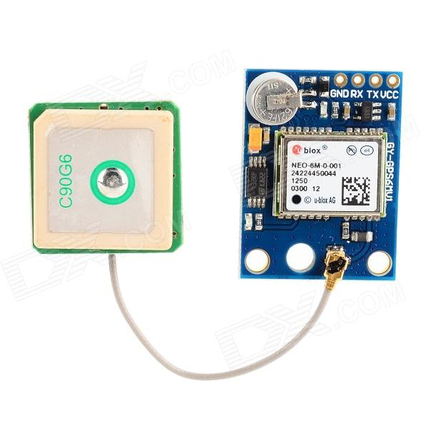
WHAT IS GPS?
GPS or Global Positioning System is a network of orbiting satellites that send precise details of their position in space back to earth.
Eg. Airlines, shipping companies, trucking firms, and drivers everywhere use the GPS system to track vehicles.

Slide 13
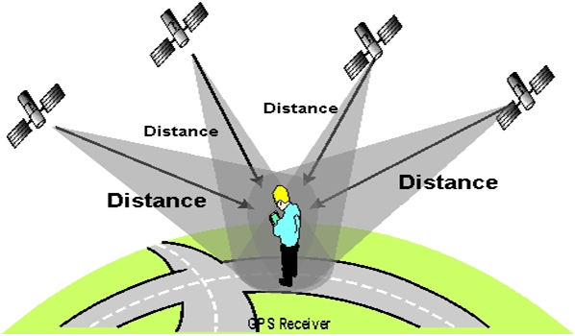
HOW DOES IT WORK?
There are three parts to a GPS system.
The satellites send out microwave signals.
The process is based on trilateration process.

Slide 14
FLOWCHART/WORKING
Storage of Restricted Area
Data from The GPS
Compare the position
If nearer to restricted Area
No
B
A

Slide 15
FLOWCHART CONTINUES
A
B
Alarm Sounds keep on Increasing and Engine Sounds Keep reducing by 25%
If Reaches the restricted area
Engine Gets Off
No

Slide 16
FUTURE SCOPE
The process of directing the fishermen can be enhanced by placing the engine control unit system in the coastal office. They remotely control the engine to restart the boat for the safety of fishermen.

